Slide 1
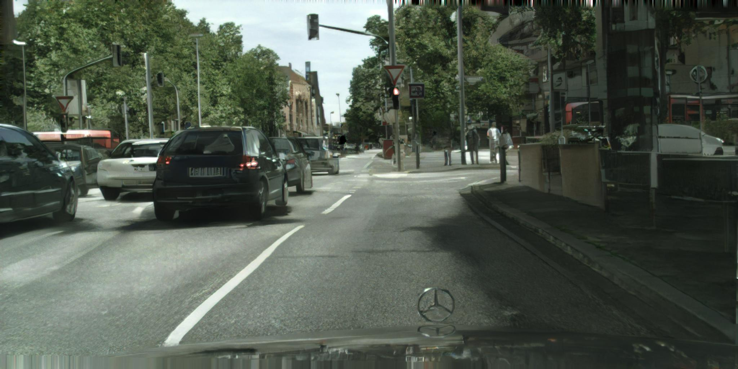
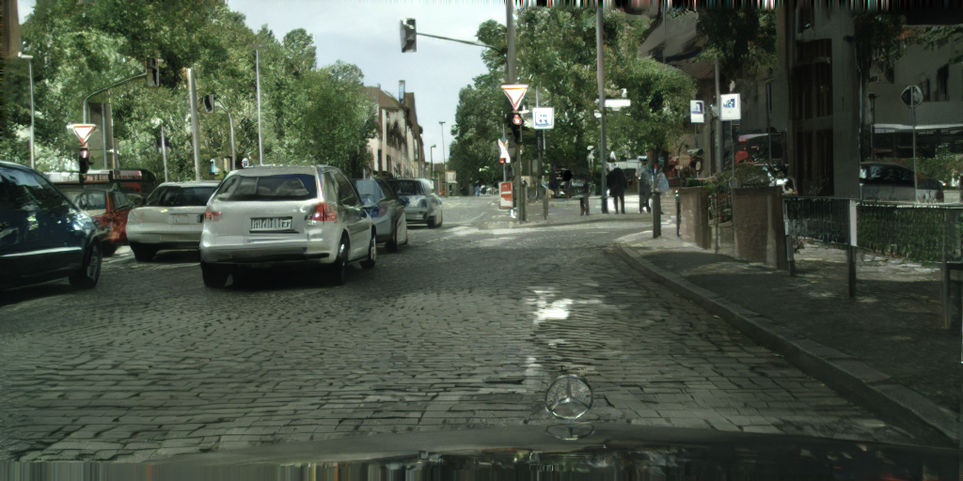
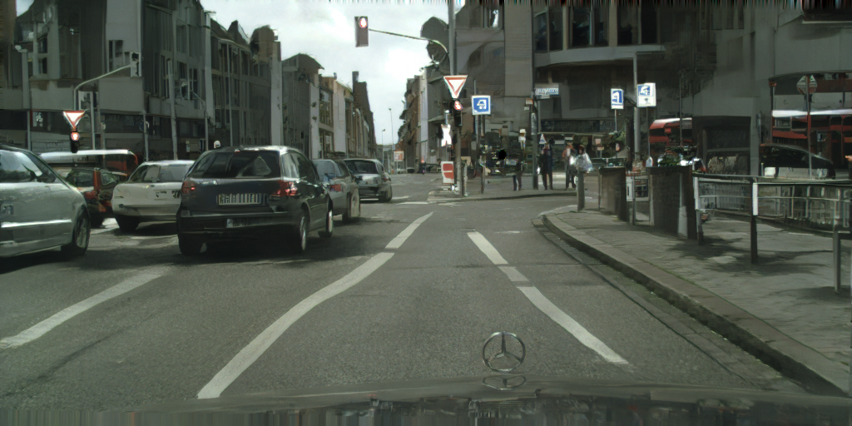
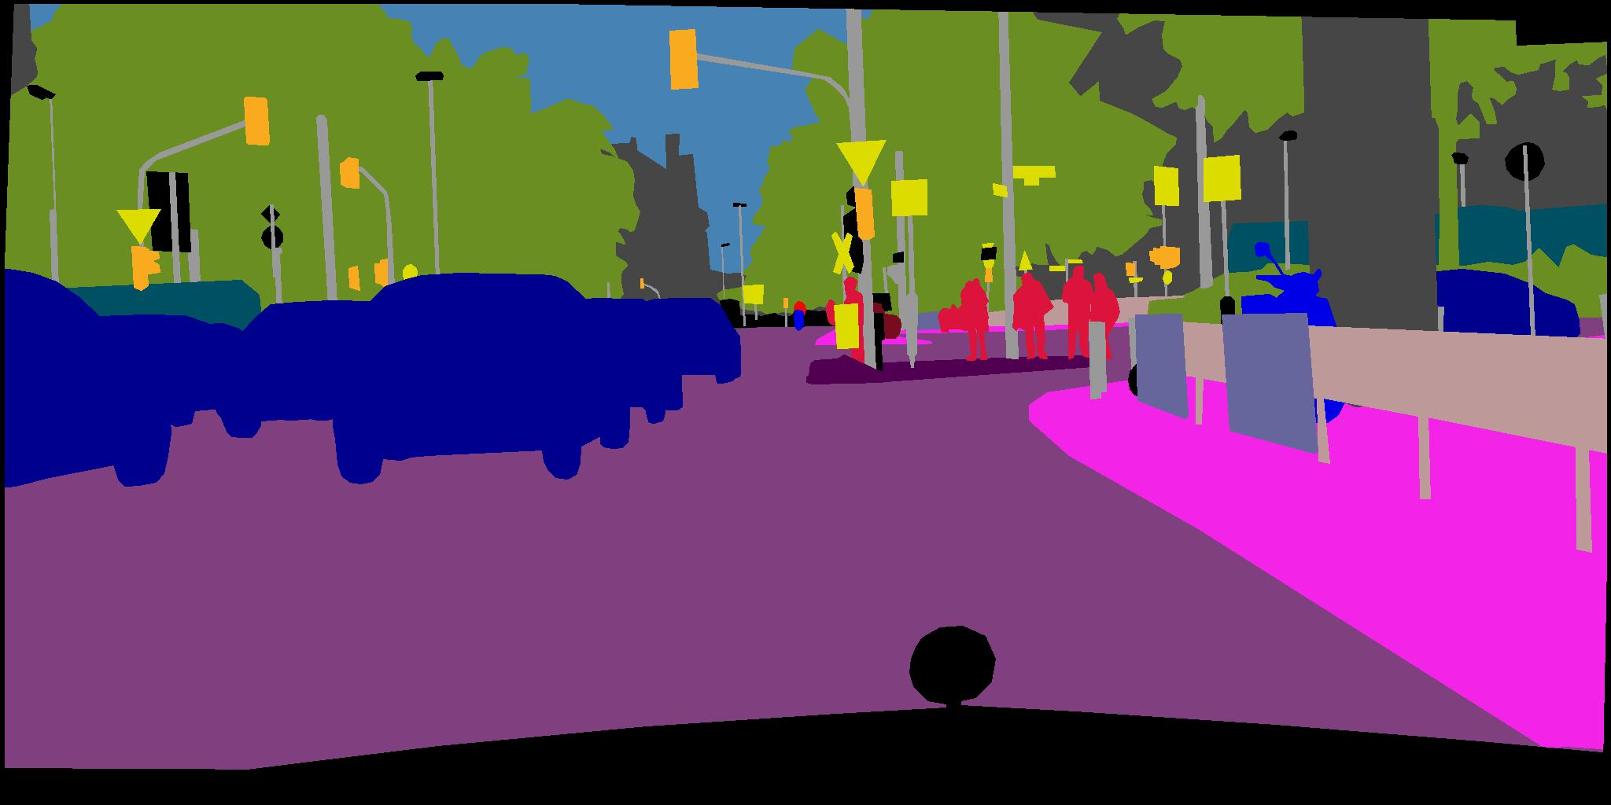
High-Resolution Image Synthesis and Semantic Manipulation with Conditional GANs （pix2pixHD)
Ting-Chun Wang, Ming-Yu Liu, Jun-Yan Zhu, Andrew Tao, Jan Kautz, Bryan Catanzaro
Notes:
Thanks for

Slide 2
Outline
Introduction
Related work
Method
Results
Applications
Conclusion

Slide 3
Outline
Introduction
Related work
Method
Results
Applications
Conclusion

Slide 4
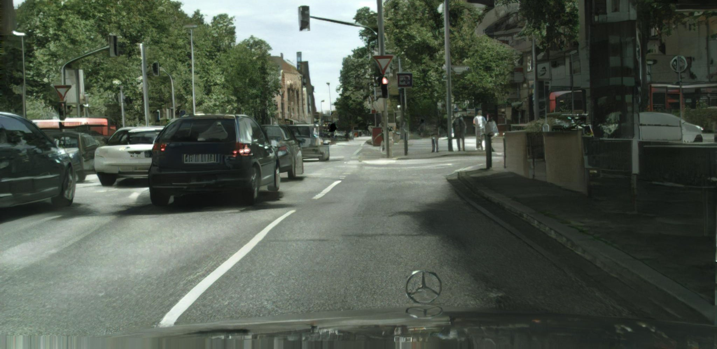
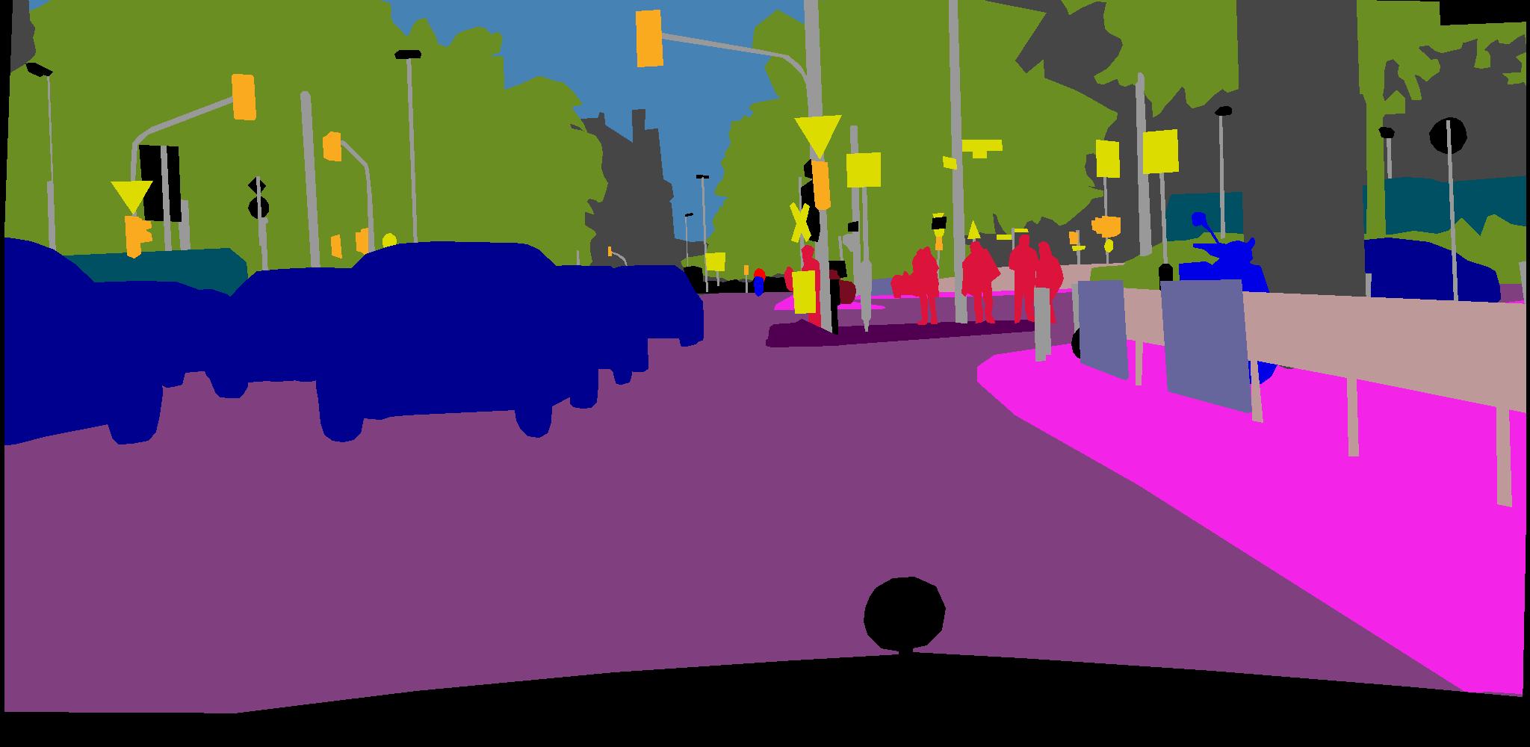
Introduction
Building
Tree
Car
Road
Sidewalk

Slide 5
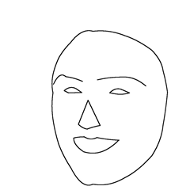
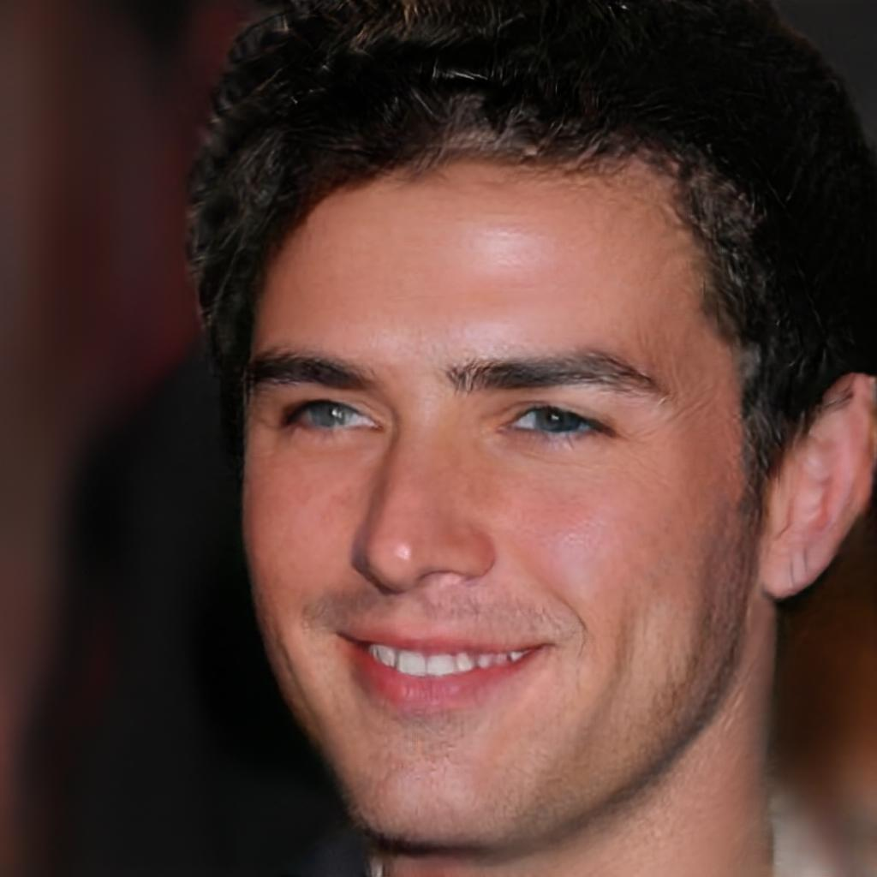
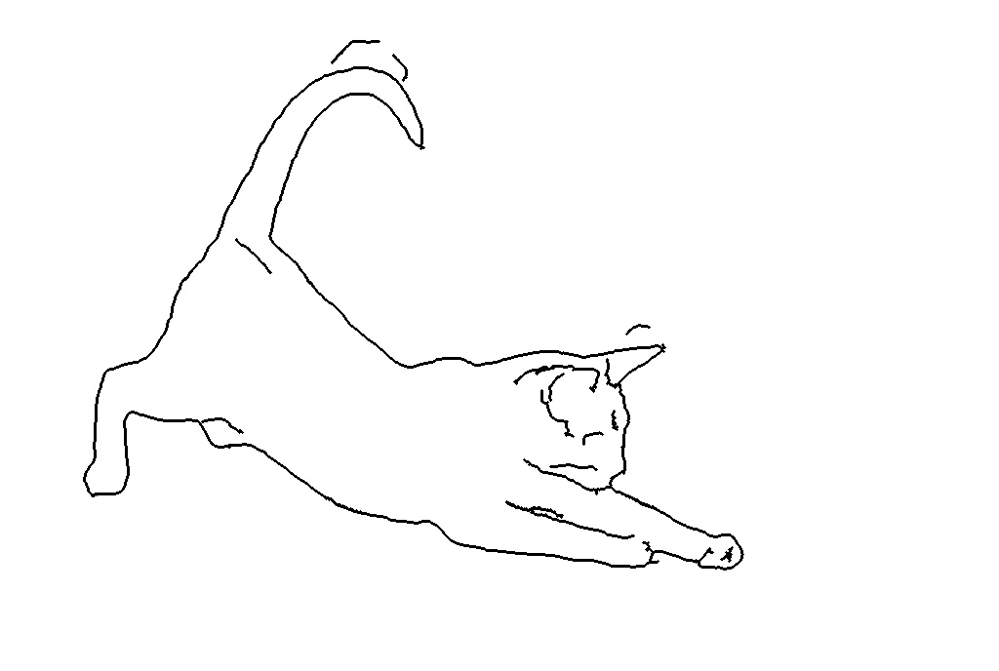
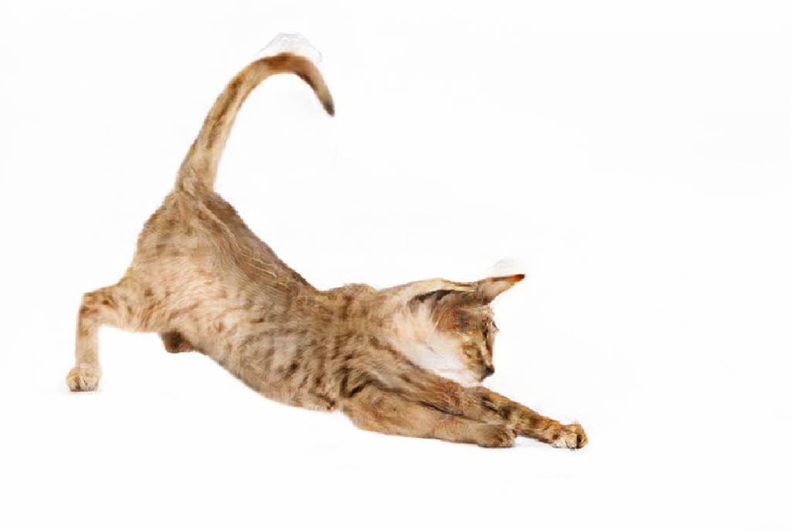
Introduction

Slide 6
Outline
Introduction
Related work
Method
Results
Applications
Conclusion

Slide 7
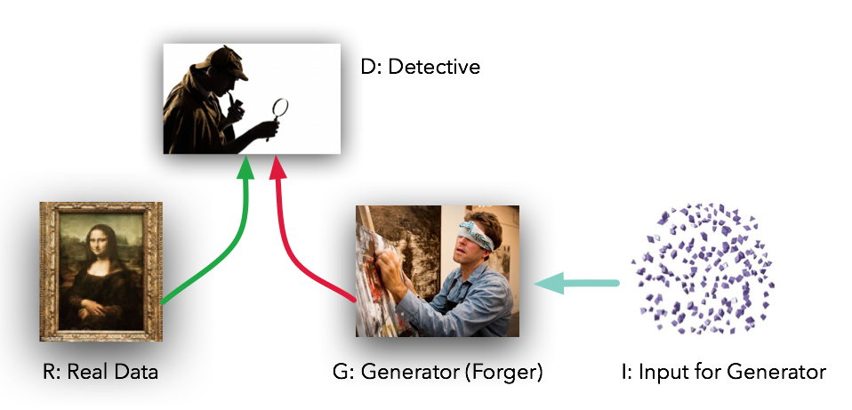
Related Work
Generative Adversarial Network (GAN)
Goodfellow et al. [2014] Radford et al. [2015] Arjovsky et al. [2017]
Figure from: https://medium.com/@devnag/

Slide 8
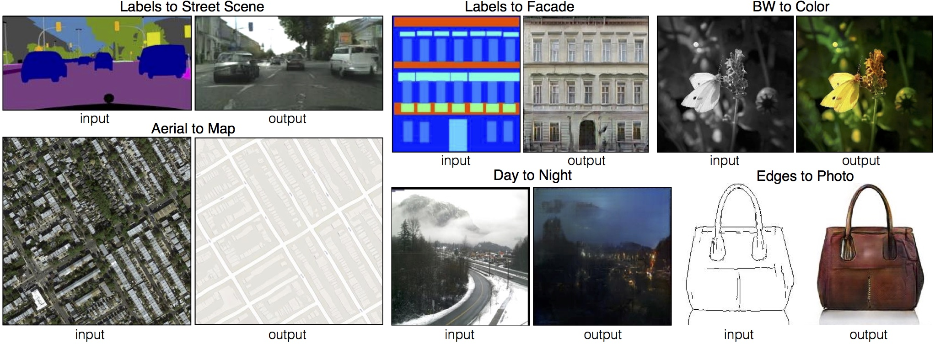
Related Work
Generative Adversarial Network (GAN)
Image-to-Image Translation
Low resolution
Goodfellow et al. [2014] Radford et al. [2015] Arjovsky et al. [2017]
Johnson et al. [2016] Isola et al. [2017]

Slide 9
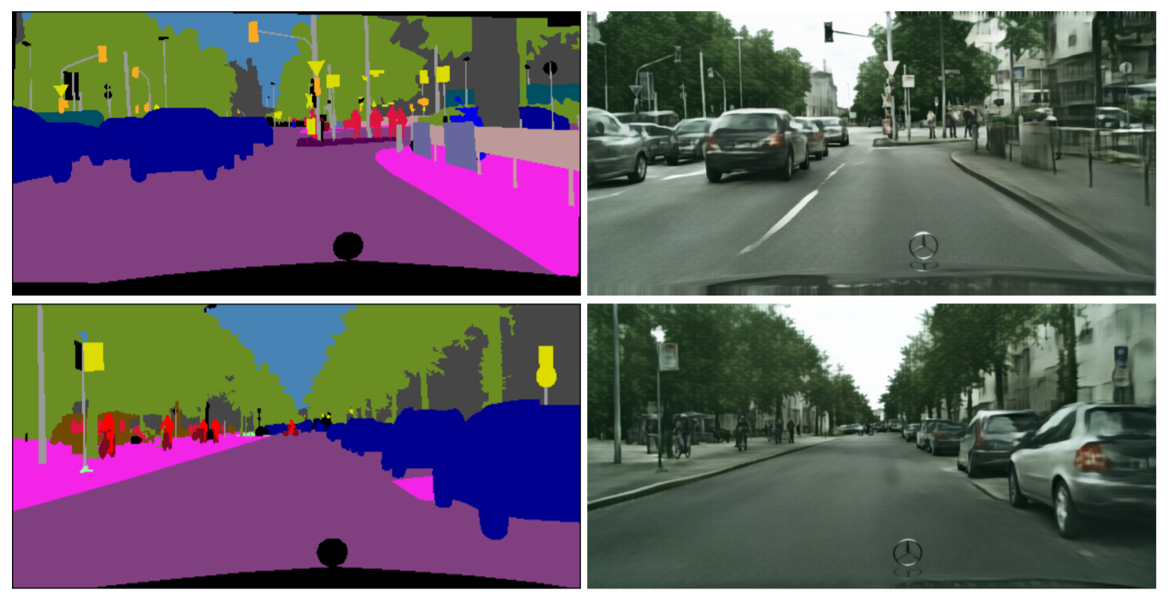
Related Work
Generative Adversarial Network (GAN)
Image-to-Image Translation
Low resolution
Goodfellow et al. [2014] Radford et al. [2015] Arjovsky et al. [2017]
Johnson et al. [2016] Isola et al. [2017]
Cascaded Refinement Network (CRN)
Lack fine details
Chen and Koltun [2017]

Slide 10
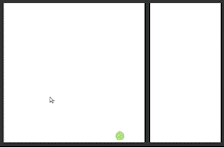
Related Work
Generative Adversarial Network (GAN)
Image-to-Image Translation
Low resolution
High Resolution Image
Goodfellow et al. [2014] Radford et al. [2015] Arjovsky et al. [2017]
Johnson et al. [2016] Isola et al. [2017]
Cascaded Refinement Network (CRN)
Deep Visual Manipulation
Semantic Manipulation
Lack fine details
Chen and Koltun [2017]
Zhu et al. [2016] Zhang et al. [2017]

Slide 11
Outline
Introduction
Related work
Method
Baseline method
Our method
Results
Applications
Conclusion

Slide 12
Baseline Method
pix2pix

Slide 13
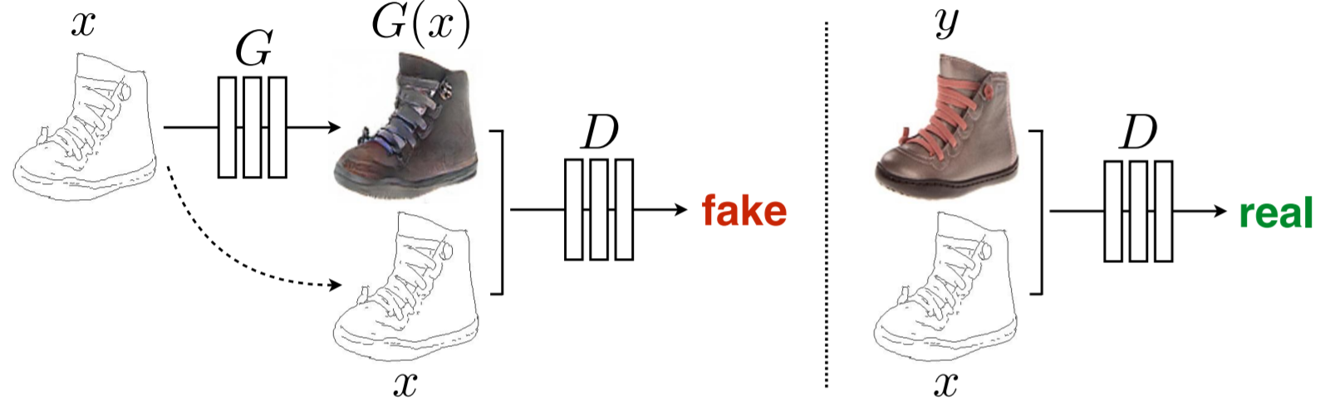
Baseline Method
pix2pix: training discriminator
input
fake
real
input
input

Slide 14
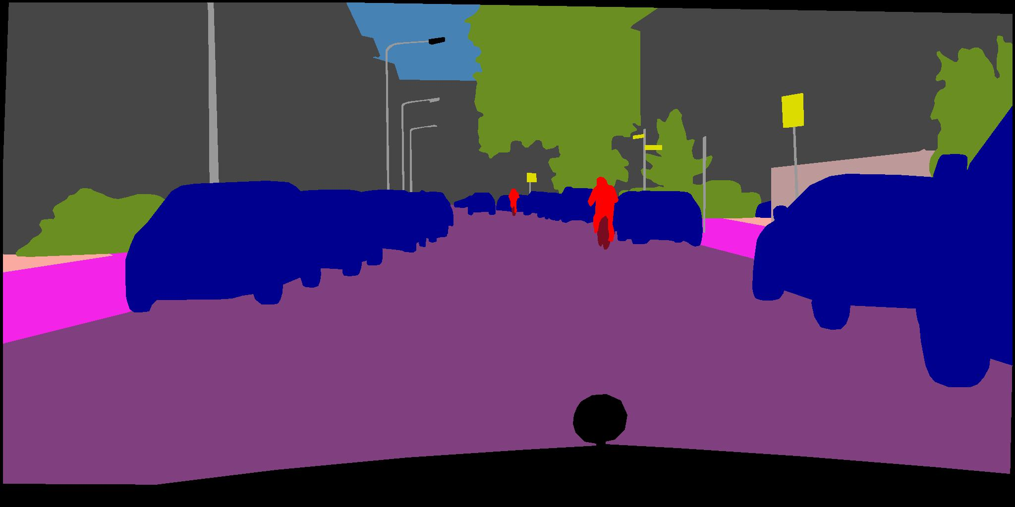
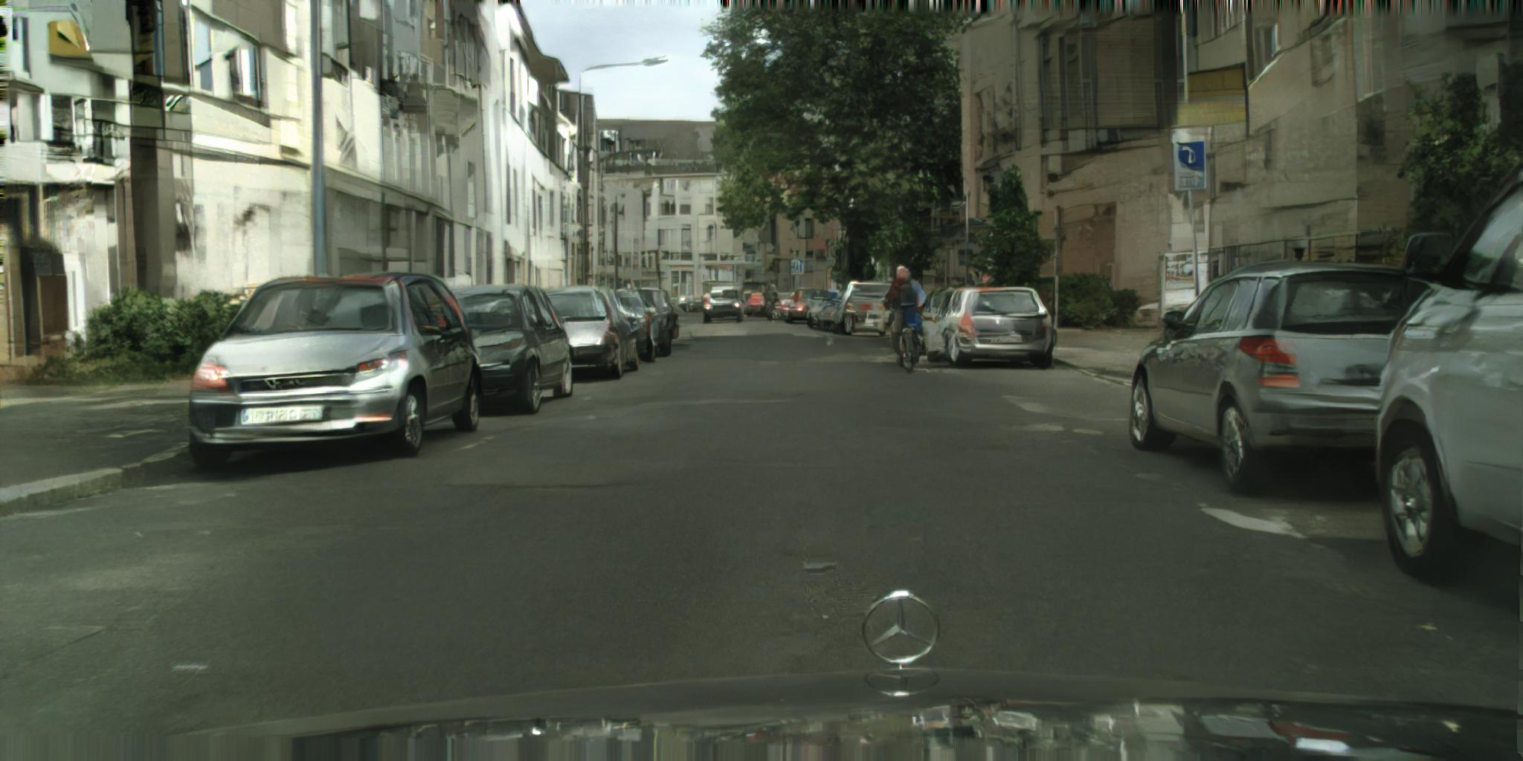
Baseline Method
pix2pix: training generator
input
fake
generator
fixed
discriminator
input

Slide 15
Outline
Introduction
Related work
Method
Baseline method
Our method
Results
Applications
Conclusion

Slide 16
Our Method
Extending to high resolution
Using instance-level segmentation maps

Slide 17
Our Method
Extending to high resolution
Generator design
Discriminator design
Objective function
Using instance-level segmentation maps

Slide 18
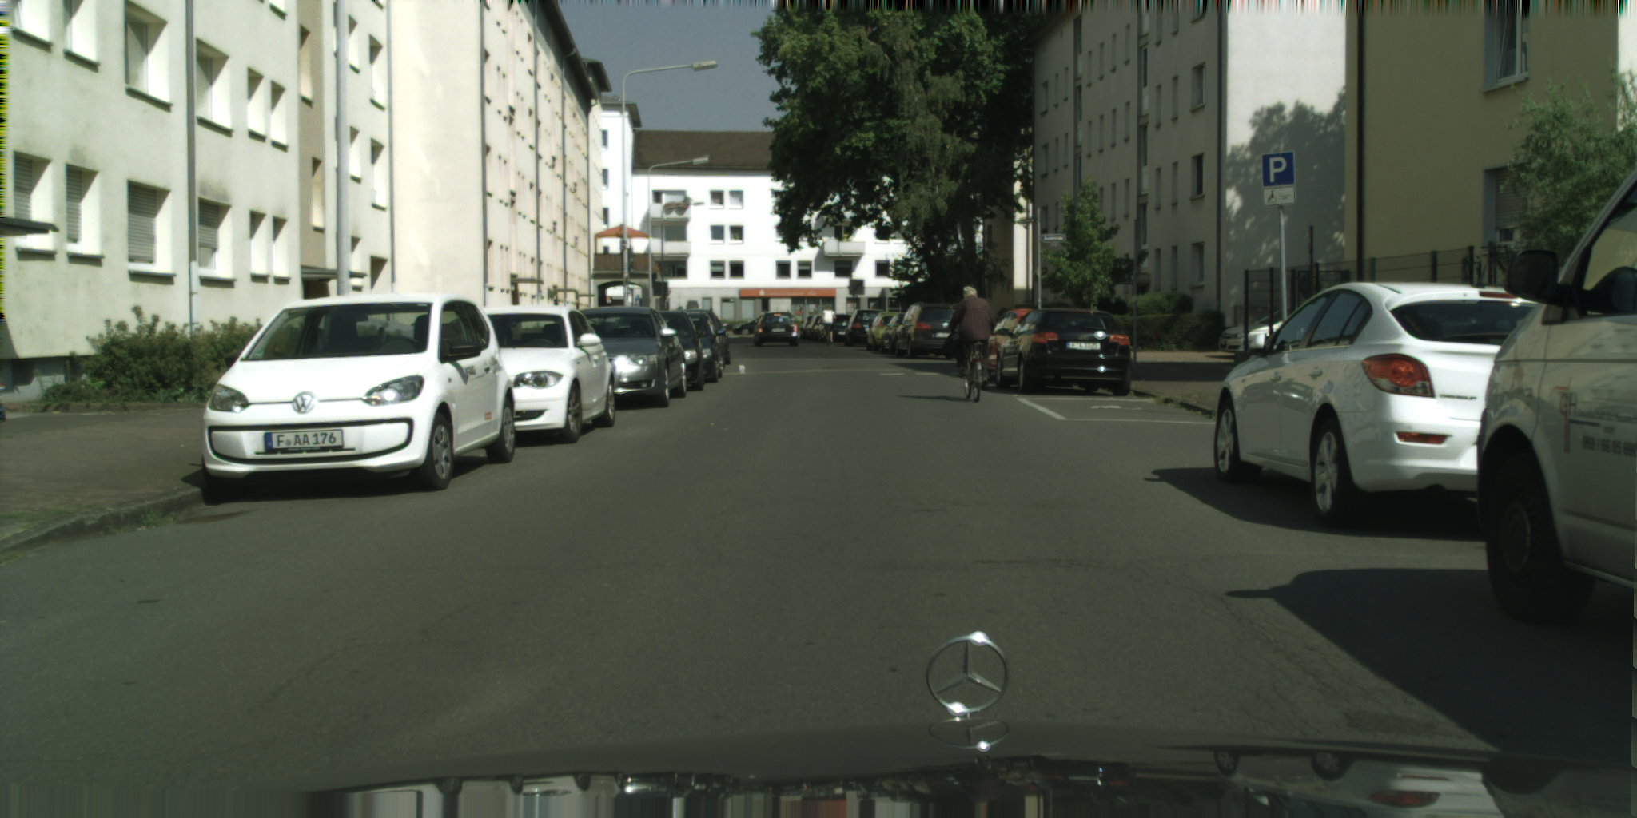
Coarse-to-fine Generator
Multi-scale Discriminators
Robust Objective
D_{i}
D_{i}
D₃
real
Residual blocks
...
match
D₂
match
...
Residual blocks
D₁
2
real
synthesized
real
synthesized

Slide 19
Coarse-to-fine Generator
Multi-scale Discriminators
Robust Objective
D_{i}
D_{i}
D₃
real
Residual blocks
...
match
D₂
match
...
Residual blocks
D₁
2
real
synthesized
real
synthesized

Slide 20
Coarse-to-fine Generator
Multi-scale Discriminators
Robust Objective
D_{i}
D_{i}
D₃
real
Residual blocks
...
match
D₂
match
...
Residual blocks
D₁
2
real
synthesized
real
synthesized

Slide 21
Coarse-to-fine Generator
Multi-scale Discriminators
Robust Objective
D_{i}
D_{i}
D₃
real
Residual blocks
...
match
D₂
match
...
Residual blocks
D₁
2
real
synthesized
real
synthesized

Slide 22
Our Method
Extending to high resolution
Using instance-level segmentation maps
Boundary improvement
Multi-modal results using feature embedding

Slide 23
Our Method
Extending to high resolution
Using instance-level segmentation maps
Boundary improvement
Multi-modal results using feature embedding

Slide 24

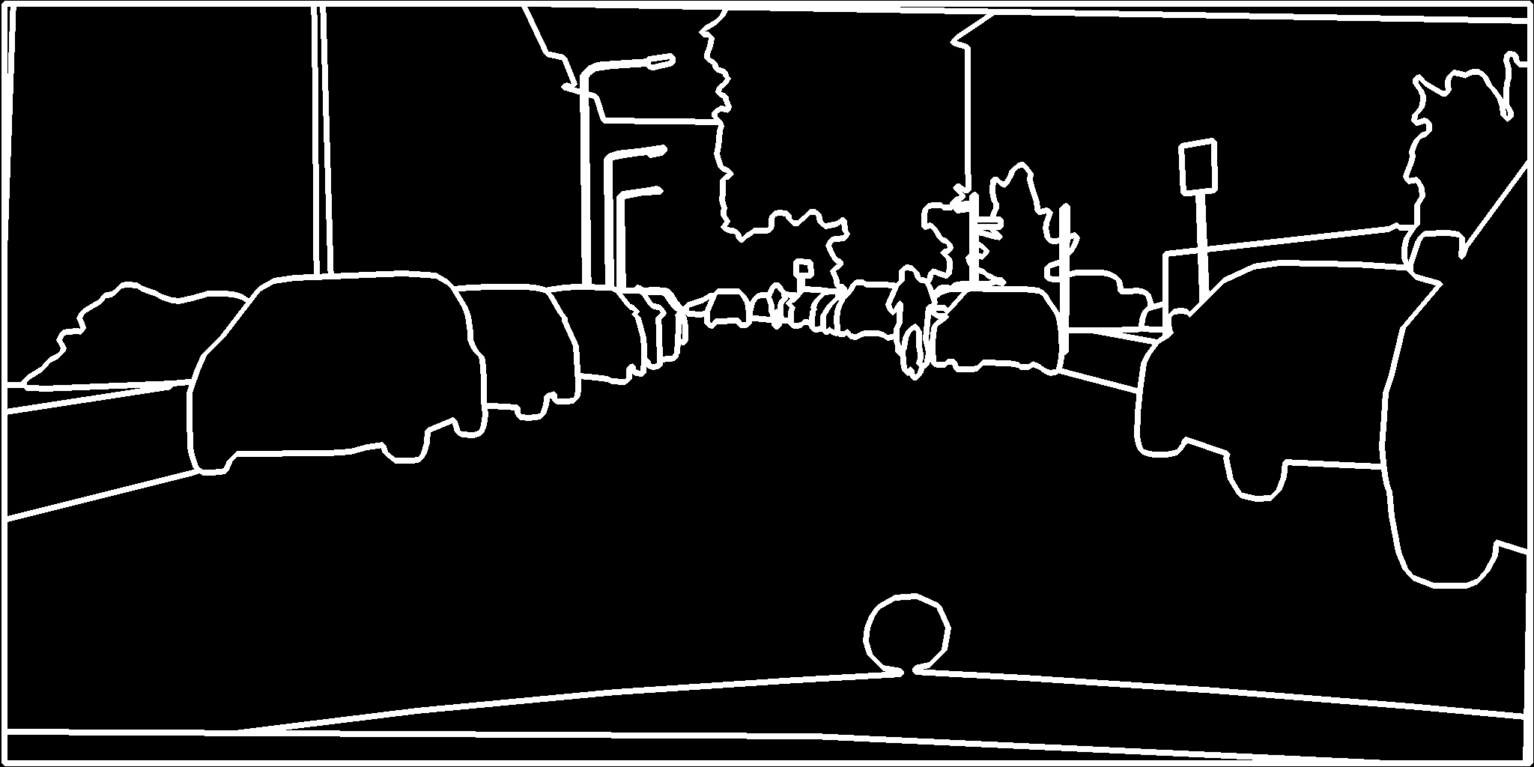
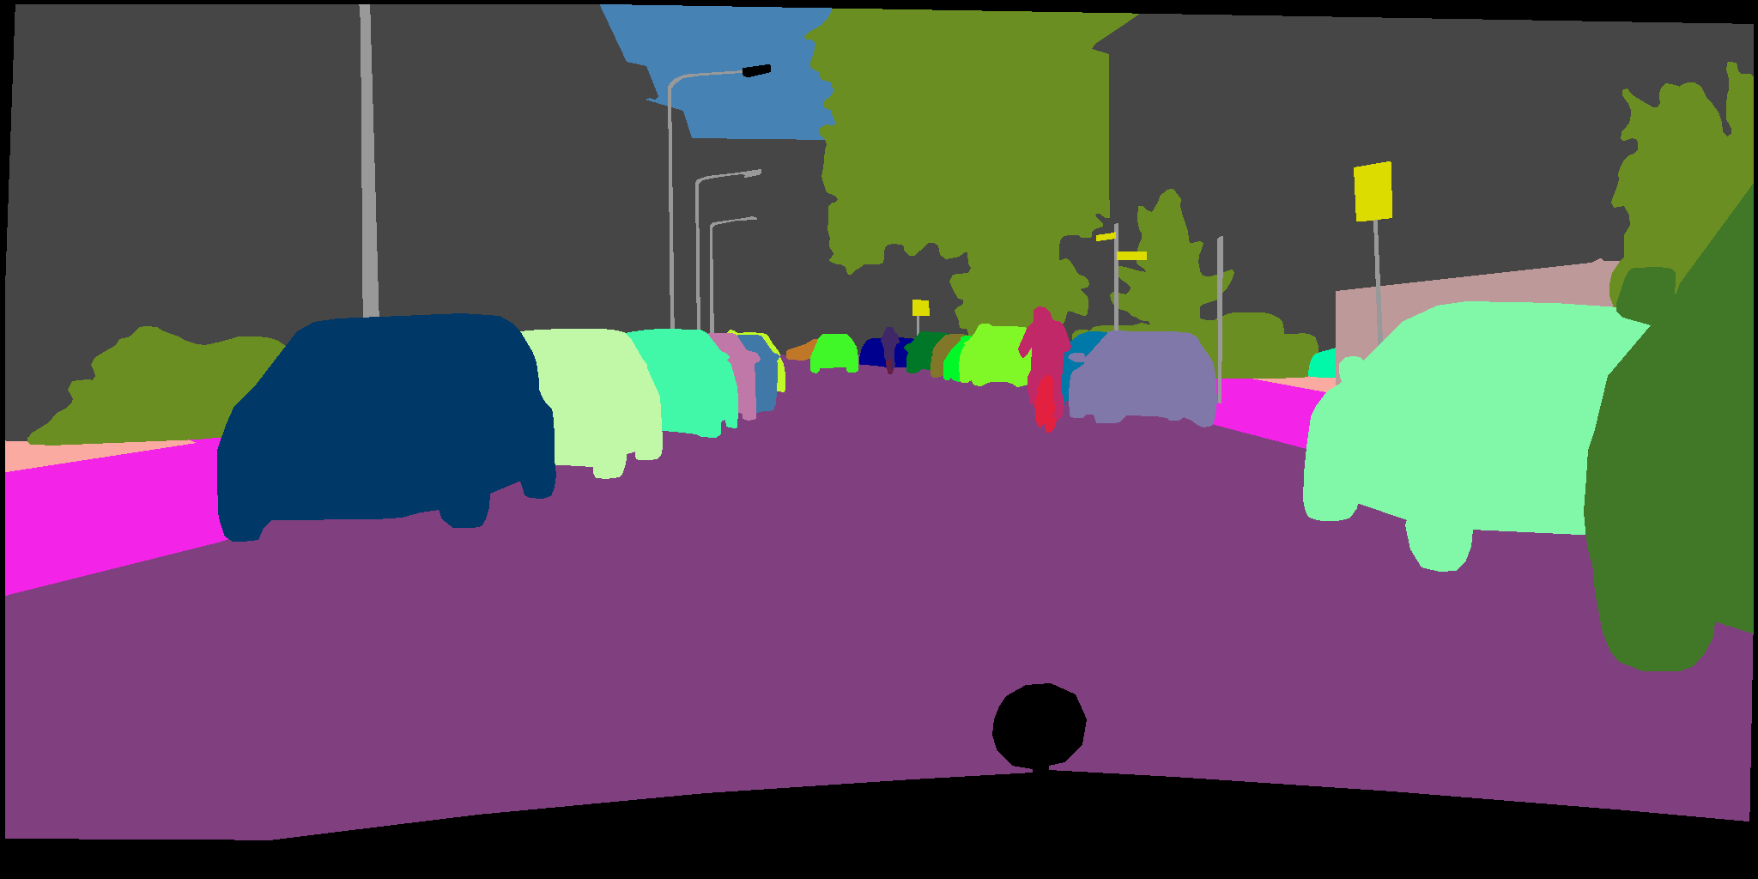
Our Method
Boundary improvement

Slide 25
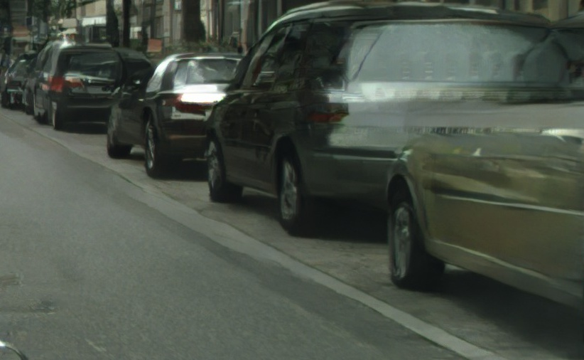
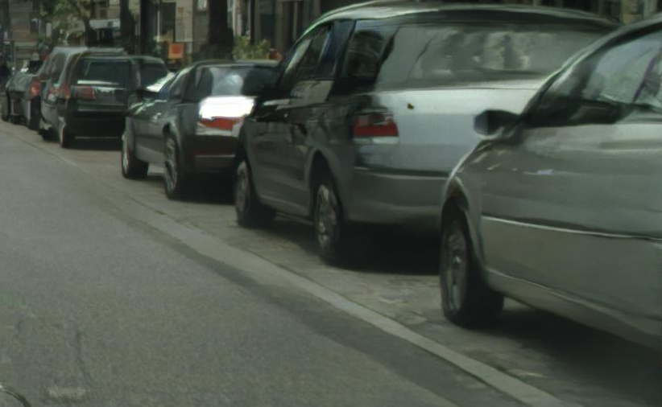
Our Method
Boundary improvement
without instance maps
with instance maps

Slide 26
Our Method
Extending to high resolution
Using instance-level segmentation maps
Boundary improvement
Multi-modal results using feature embedding

Slide 27
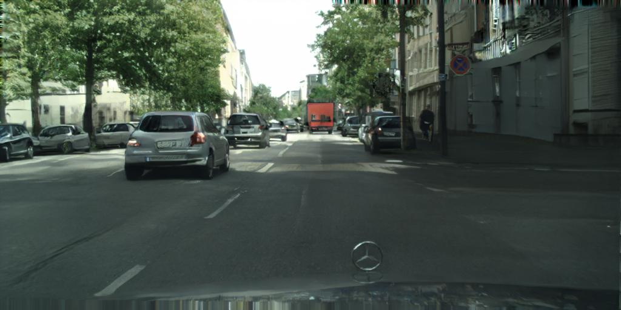
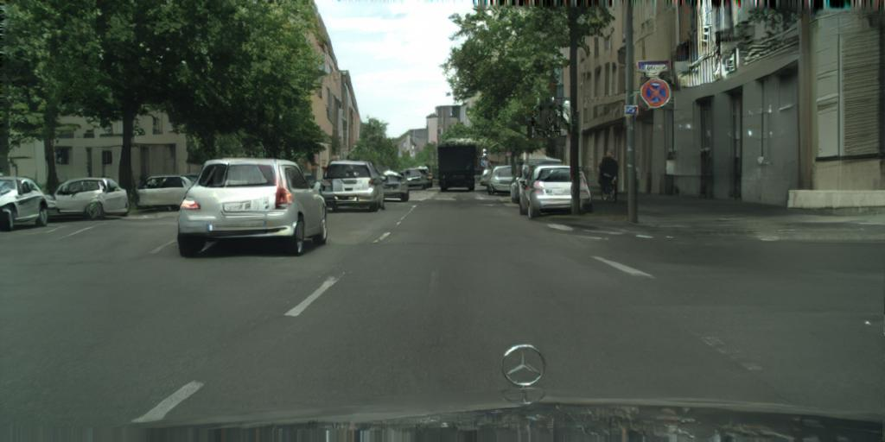
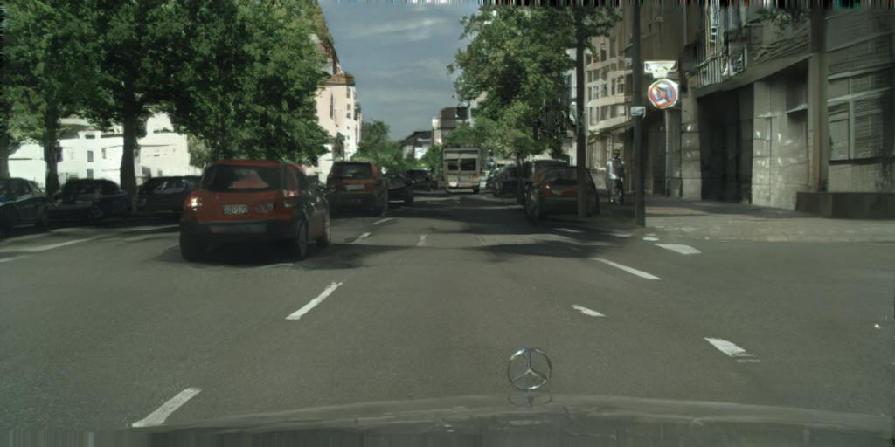
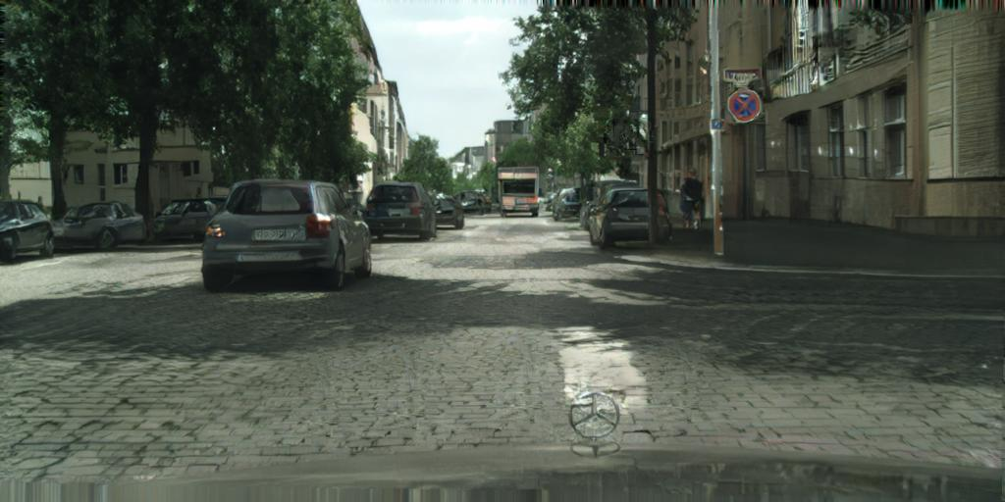
Our method
Multi-modal results

Slide 28
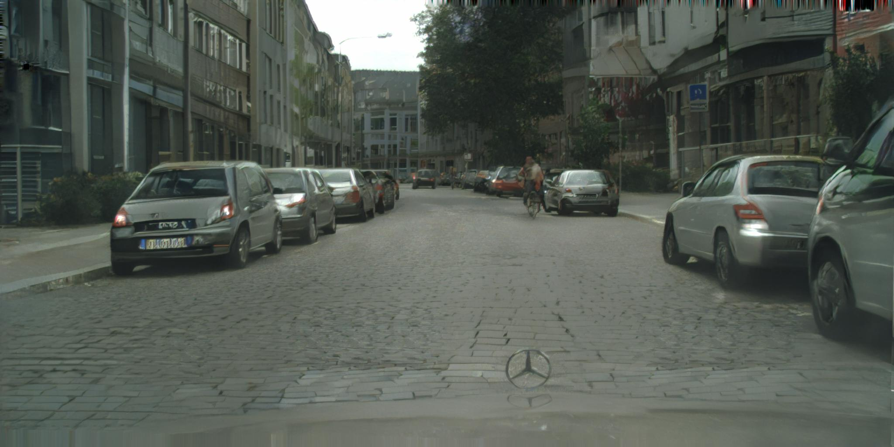
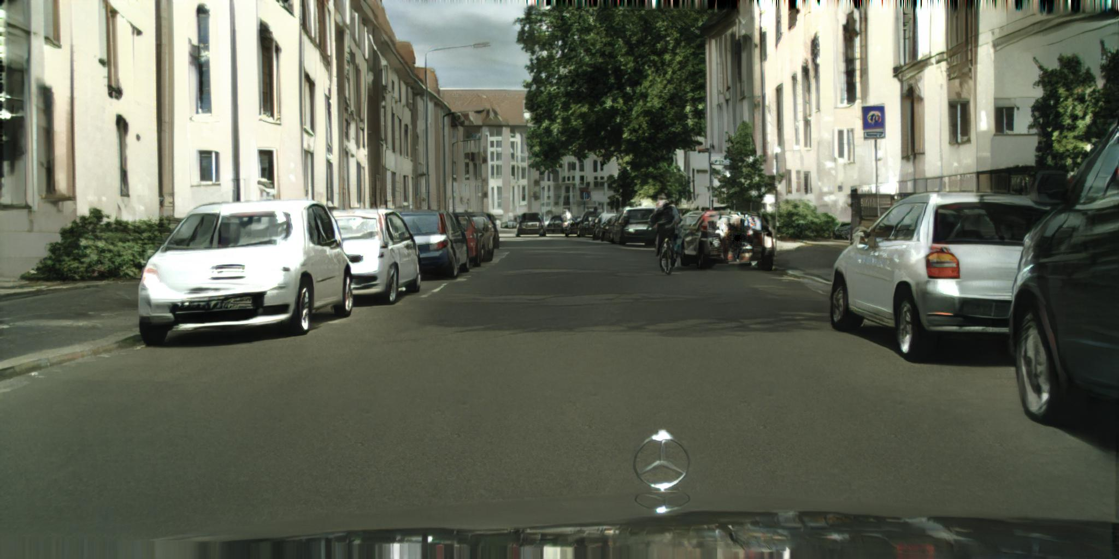
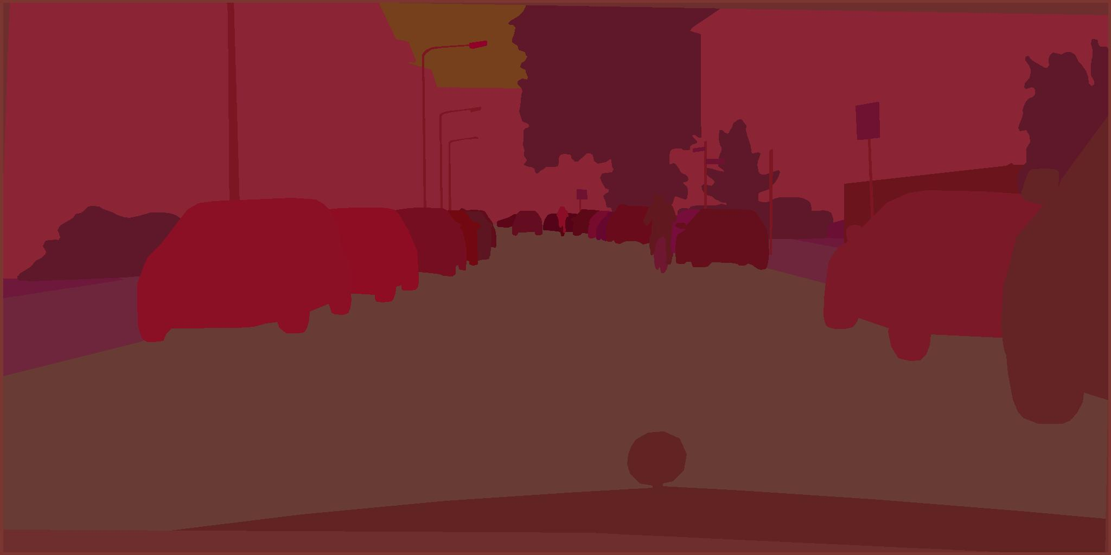
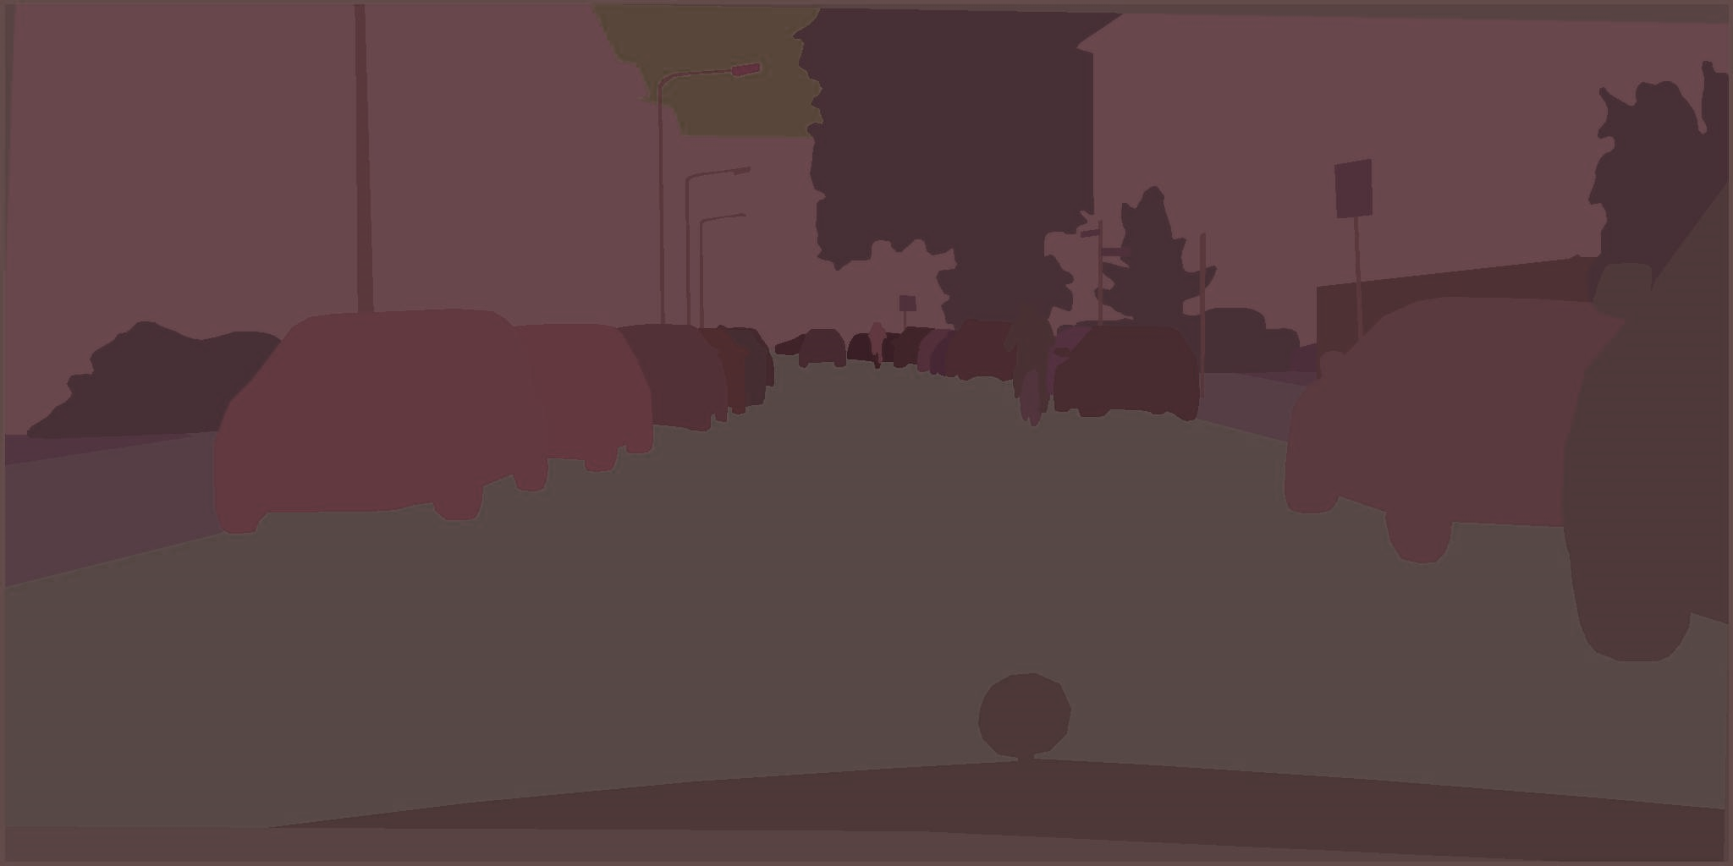
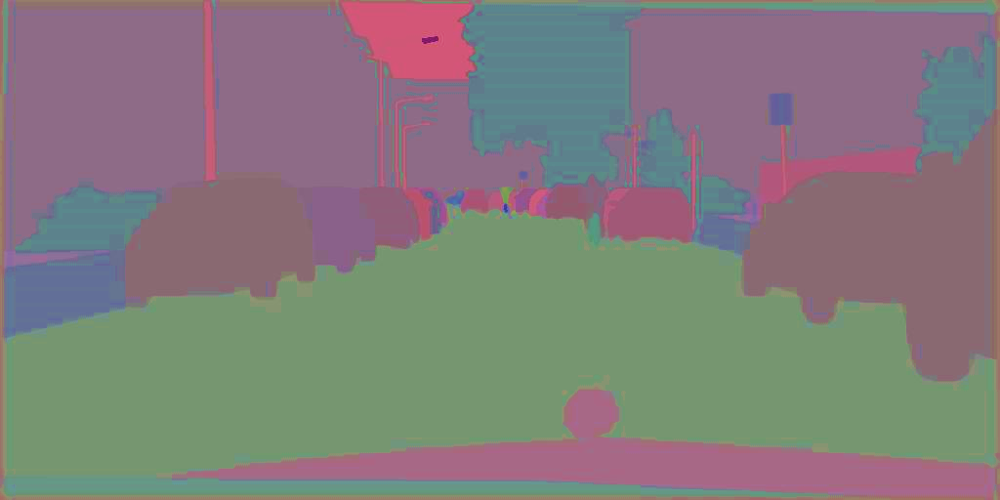
Feature Embedding Scheme
Labels
Synthesized
Features
Image generation network
Real
Features
Instance-wise pooling
Feature encoder network

Slide 29

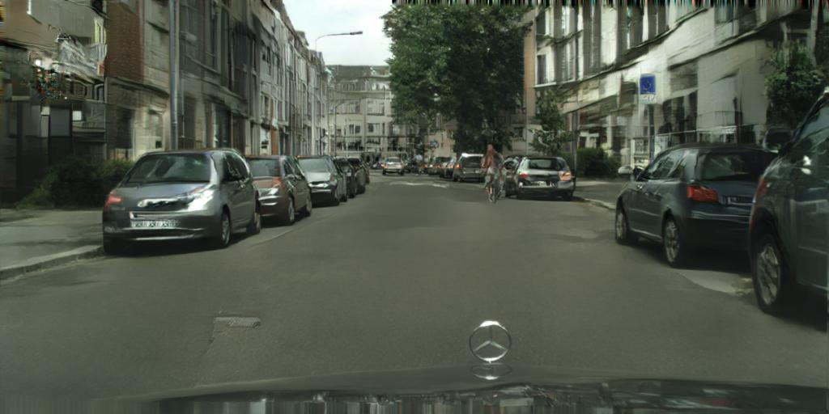
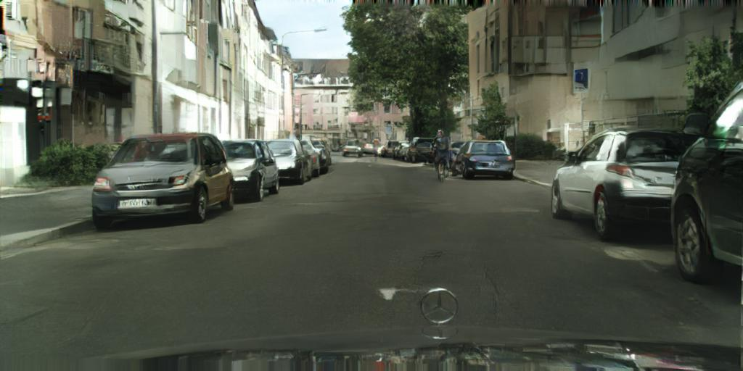
Mixed-Precision Training
input
fp16 (mixed-precision) result
fp32 result
Notes:
The last thing I want to mention is that our model can also be trained in floating point 16, or mixed precision training, instead of traditional fp32. We can see the error graph for using both precisions looks similar, and the results by using fp16 and by using fp32 look very similar too. But you can imagine using fp16 is much faster and consumes much less memory.

Slide 30
Outline
Introduction
Related work
Method
Results
Applications
Conclusion

Slide 31
Results
Comparisons with
pix2pix [Isola et al. 2017]
CRN [Chen and Koltun 2017]
Datasets
Cityscapes
NYU
ADE20K
Helen Face
CelebA-HQ

Slide 32
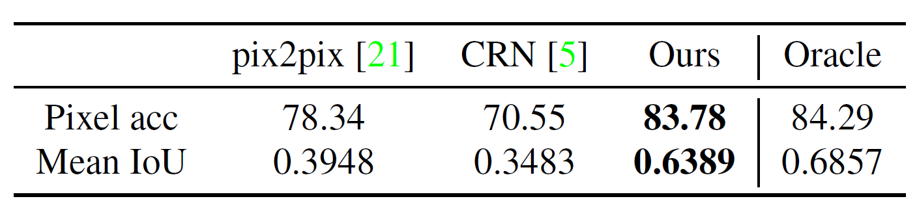
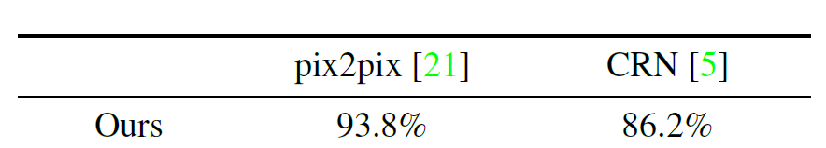
Results
Quantitative comparisons (Cityscapes)
Semantic segmentation scores
Subjective user study scores

Slide 33
Results
Qualitative comparisons

Slide 34
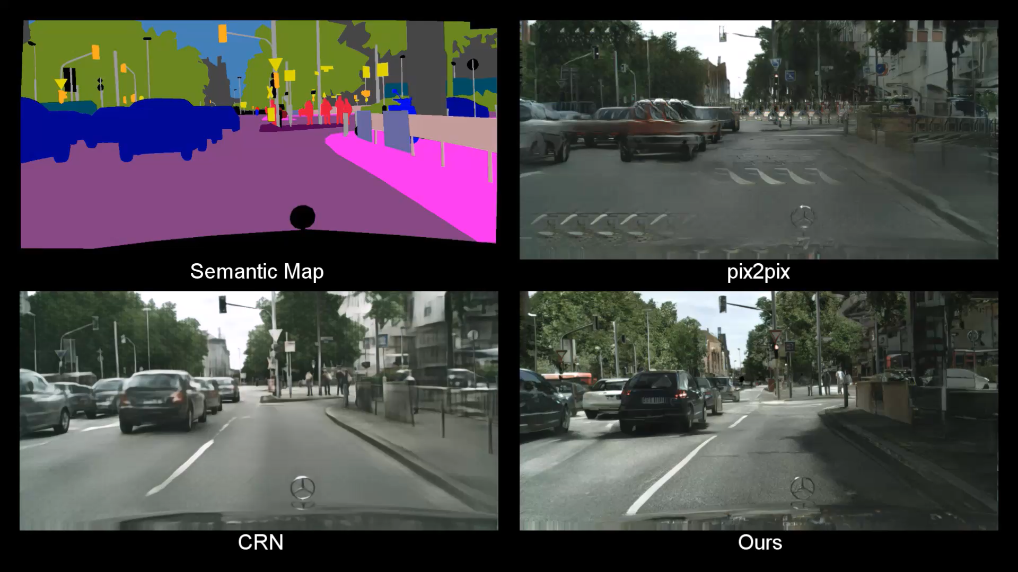
Results
Qualitative comparisons

Slide 35
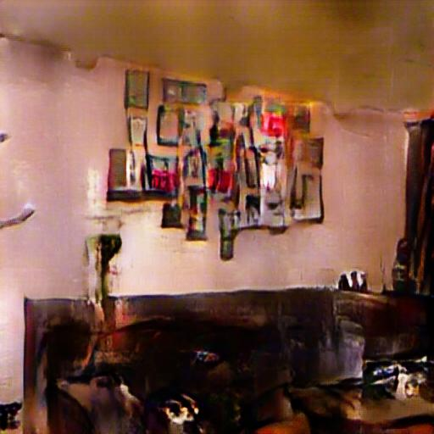
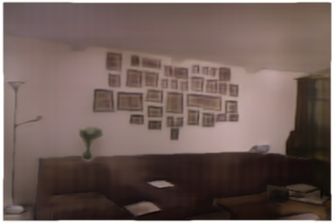
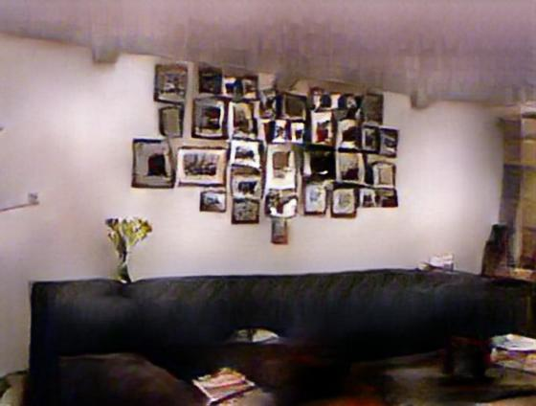
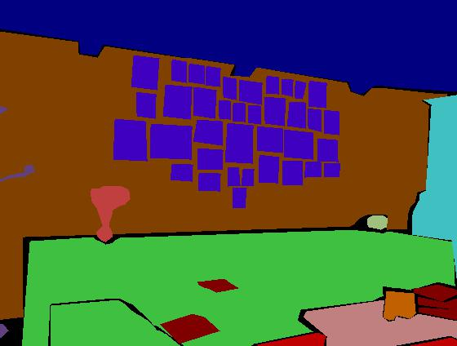
Results
NYU
pix2pix
CRN
Ours

Slide 36
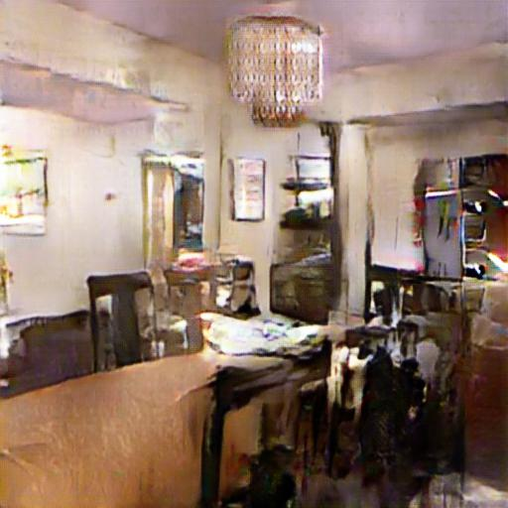
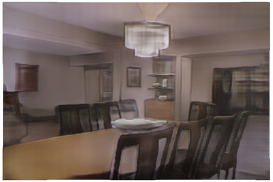
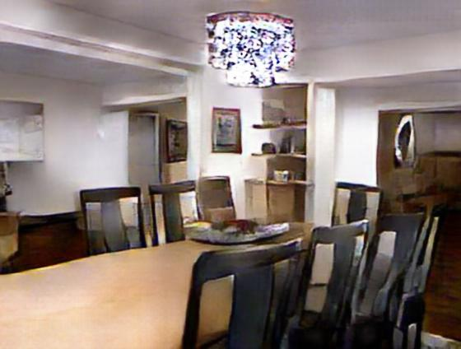
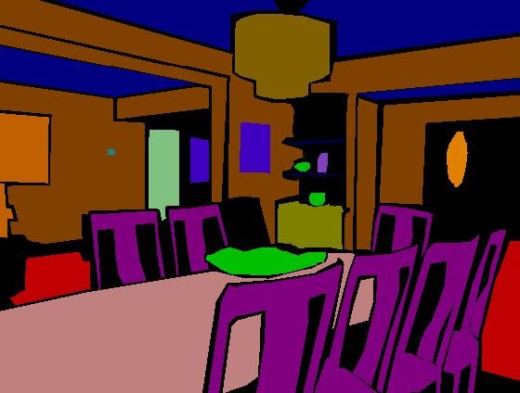
Results
NYU
pix2pix
CRN
Ours

Slide 37
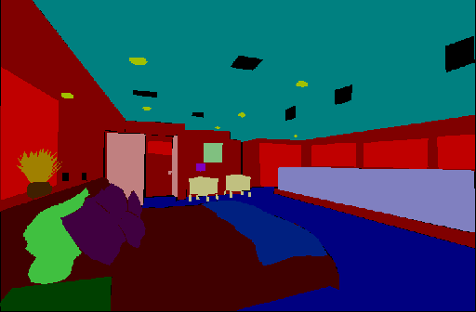
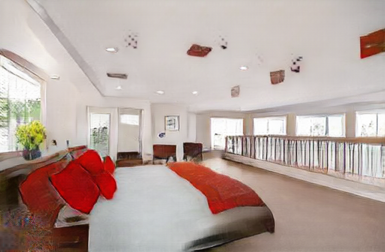
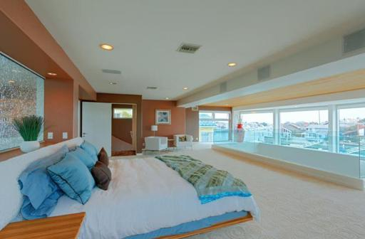
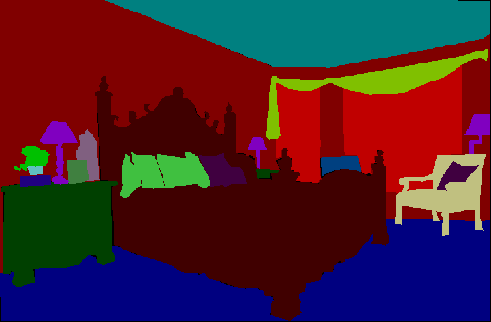
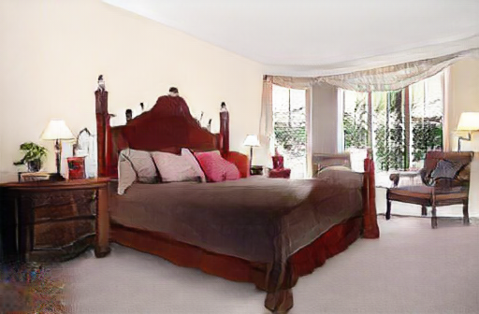
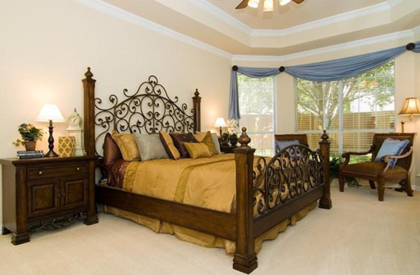
Results
ADE20K
Labels
Ours
Ground truth

Slide 38




Results
Helen Face: multi-modal results
Changing skin colors

Slide 39




Results
Helen Face : multi-modal results
Adding eyebrows / beards

Slide 40


Results
CelebA-HQ
Edges
Synthesized
Ground truth

Slide 41



Results
CelebA-HQ
Edges
Synthesized
Ground truth

Slide 42



Results
CelebA-HQ
Edges
Synthesized
Ground truth

Slide 43



Results
CelebA-HQ
Edges
Synthesized
Ground truth

Slide 44
Outline
Introduction
Related work
Method
Results
Applications
Conclusion

Slide 45

Applications: style changing

Slide 46

Applications: style changing
Changing styles

Slide 47

Applications: style changing

Slide 48

Applications: style changing

Slide 49

Applications: label changing

Slide 50

Applications: label changing

Slide 51

Applications: adding objects

Slide 52

Applications: adding strokes

Slide 53

Applications: adding strokes

Slide 54
Outline
Introduction
Related work
Method
Results
Applications
Conclusion

Slide 55

Conclusion
We present a GAN based framework that can
Synthesize high-res realistic images

Slide 56
Conclusion
We present a GAN based framework that can
Synthesize high-res realistic images
Generate multi-model results

Slide 57
Acknowledgements
We thank the following people for helpful comments
Taesung Park, Phillip Isola, Tinghui Zhou, Richard Zhang, Rafael Valle and Alexei A. Efros

Slide 58

Thank you!
Project: https://tcwang0509.github.io/pix2pixHD/
Code: https://github.com/NVIDIA/pix2pixHD

Slide 59


Results
Quantitative comparisons
Generator choice
Semantic segmentation scores
Subjective user study

Slide 60

Results
Quantitative comparisons
Discriminator choice
Semantic segmentation scores
Subjective user study
69.2 %

Slide 61
Training details
LSGAN, Adam solver
Feature embedding:
K=10 for K-means
3-dimentional feature vector
Training:
1024x512 resolution: 12G memory GPU
2048x1024 resolution:
FP32: NVIDIA Quadro M6000 GPU (24G)
FP16: NVIDIA Volta V100 GPU (16G)

